Slide 1

Business Package Insurance

Slide 2
Business Insurance
A business insurance is like a safety belt which offers financial protection to the business from various risks. Business is not just about profits, it faces various risks as well. Safeguarding the business from unpleasant events and mishaps is extremely important for the steady growth of the business. For this reason, more and more businesses are opting for business insurance.
Types of Business Insurance
1. Business Package Policies
2. Standalone Policies

Slide 3
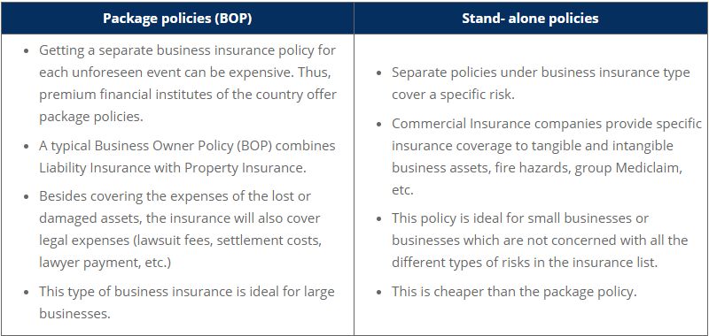
Notes:
It’s the Stakeholders which funnel or barrage ( give a meaningful flow) the entire journey of the customers through various bottle necks. They can be knowing with guided support, as which customer should be passing through which journey to accomplish the business more meaningfully.
The organization should look at them not in isolation and only as important individuals who bring in the business. Moreover, they should be looked as the customer touchpoints which bring in massive information to the organization. These rich information needs to be integrated across them to churn out the best possible business out of the system.
Example of an integrated role of various stakeholders, which may give a snap shot of the study at a very high level: A customer visits the websites again & again looking for his needed pairs of requirements, riders or protections—it gives an indicator of meeting him personally rather than a call center rep answering him– a discussion with the prospect can bring about his concerns ---his concerns can be taken care by endorsing it with proper medical checkups- technology can help the agent to fetch the needed investigation for the respective prospect---Medical reports if cautious, internal sales team can pitch in to suggest the prospect, term& conditions or exclusions to engage him for a suitable policy rather than loosing him to other competitors.

Slide 4
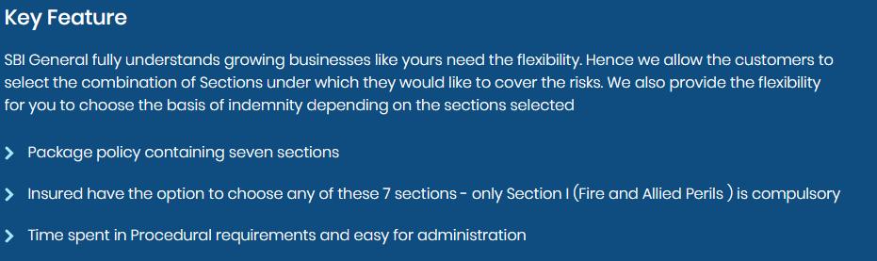
SBI General Business Package Insurance as an EXAMPLE

Slide 5
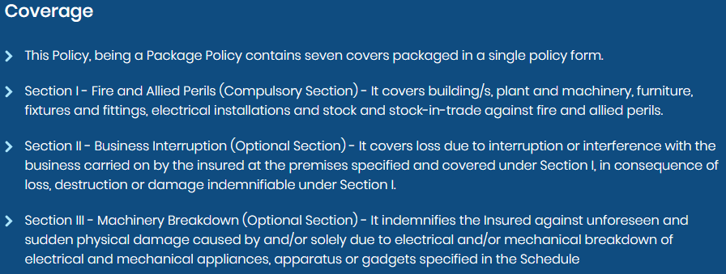
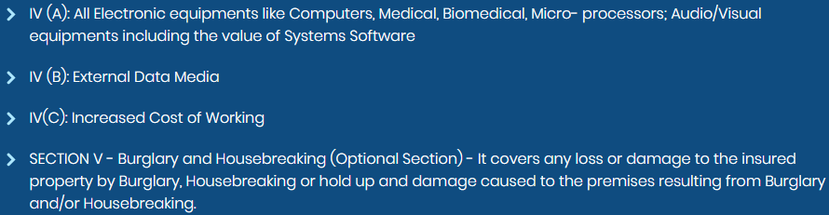
SBI General Business Package Insurance as an EXAMPLE

Slide 6
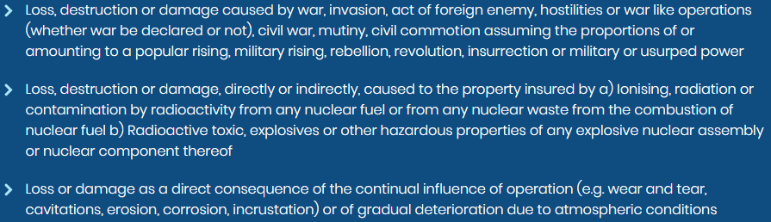
SBI General Business Package Insurance as an EXAMPLE-Exclusions

Slide 7
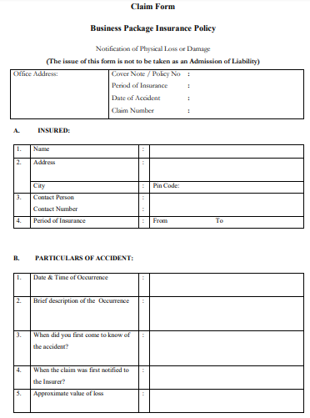
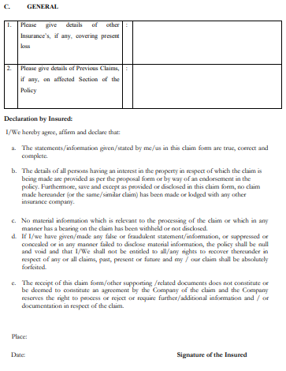
Business Package Insurance Claim Form for reference

Slide 8
Business Package Insurance Claim work flow process
Notify the insurer about the incident with calls
Responsibility of the insured
Responsibility of the insured
 |  |  |  |  |  |  |  |  |  |  |  |  | Responsibility of the insurer
 |  |  |  |  |  |  |  |  |  |  |  |  | Responsibility of the insurer
If there is any crime, law enforcement team needs to be informed
After contacting the necessary bodies, the insured should fallow up with Insurer
Adjuster from the insurance company investigates the claims
If the claim is genuine the adjuster checks the policy terms and conditions
If the insured is eligible to get the claim, amount will be paid

Slide 9
Documents Required for Claim Process
Whenever there is an eventuality, you need to immediately contact the insurance company to make claims. You should keep in place the required documents to avoid any delay or rejection. Here are some of the documents; however, the list of documents changes for different insurance plans.
Duly filled in claim forms
A picture or record of the event. This will help to substantiate the facts which have been mentioned in the claim application
Police reports, as per the need and type of insurance

Slide 10
Important Aspects of Business Package Insurance
There is an actual loss of business income.
There is suspension of activities due to the mishap.
Need to make critical repairs as soon as possible. As the insurer will need to know the repairing costs and will also ask for proper evidence.
Business owners need to inform the insurer about all aspects of the business. If any fact is not disclosed, it might invalidate the cover.
If the damage is caused due to lack of maintenance, the claim might be rejected.

Slide 11
Advantages of Buying Business Package Insurance
Compensates loss of income
Secures the employees in case of medical issues, which ultimately motivates them to perform
Improves credibility of the business in the eyes of clients and employees. Some clients might not enter into a contract if the business is not insured.

Slide 12
Suggested Watch
https://www.irdai.gov.in/ADMINCMS/cms/Uploadedfiles/54_Business%20Package%20Insurance%20Policy.pdf
Business Insurance: A Quick & Easy Overview - https://youtu.be/1sRL61C0r4Y
https://www.libertyinsurance.in/Docx/Business%20Package%20Insurance.pdf

Slide 13


